Slide 1


Slide 2


Slide 3

Task 3: - Finding Vulnerabilities on website
http://testasp.vulnweb.com

Slide 4
The website was built with the intention to test the Acunetix Web Vulnerability Scanner. For this reason this website have lot of bugs to demonstrate the forementioned software's capabilities to find those bugs. It allows the attacker to combine the results of two or more SELECT statements into a single result. It is an automated web application security testing tool that audits your web applications by checking for vulnerabilities like SQL Injection, Cross site scripting, and other exploitable vulnerabilities.

Slide 5
Vulnerability Report on SQL INJECTION
SQL injection, also known as SQLI, is a common attack vector that uses malicious SQL code for backend database manipulation to access information that was not intended to be displayed. This information may include any number of items, including sensitive company data, user lists or private customer details.
Mainly SQLI is perform on login page.

Slide 6
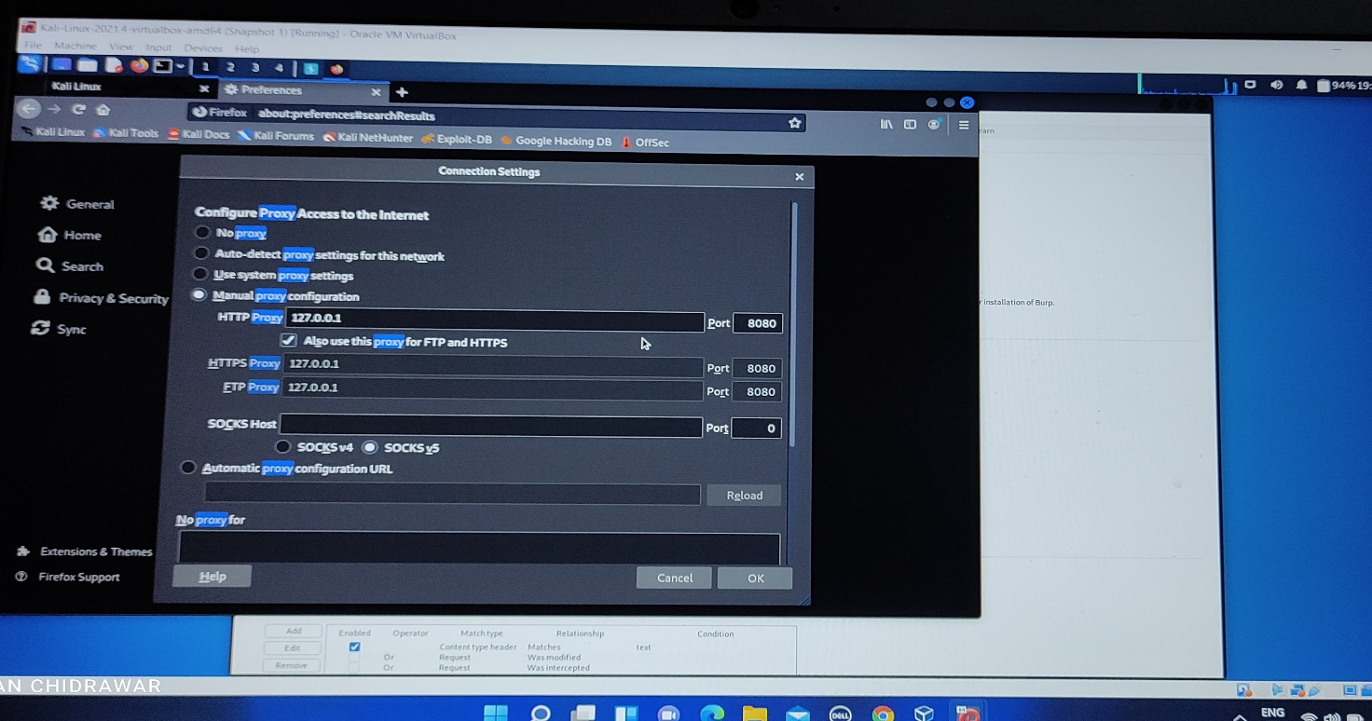
Steps to reproduce: -
1) To execute SQLI I have used Burp Suite.
2) Firstly, we need to set up the proxy on the browser after listening the proxy of Burp Suite.
As my burp suite is listening 127.0.0.1 on 8080 port. Here is the setting of proxy on browser.

Slide 7
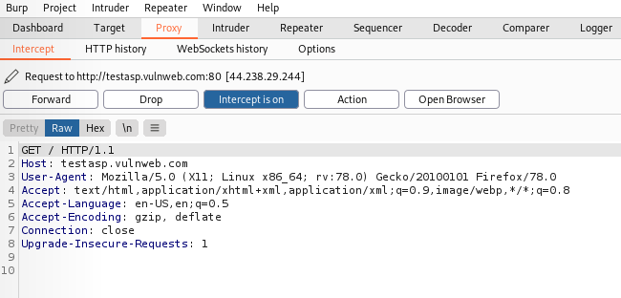
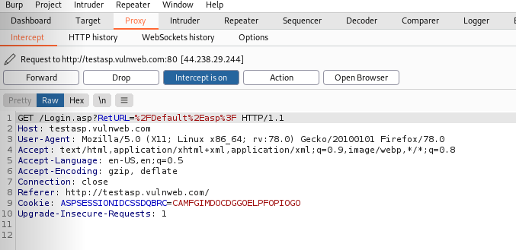
3) Visit the website http://testasp.vulnweb.com/
4) The request will send to Burp Suite. Then just click forward tab , website will get open on browser.
5) Click on login tab. Request will be send to Burp Suite. Just click on Forward tab.

Slide 8
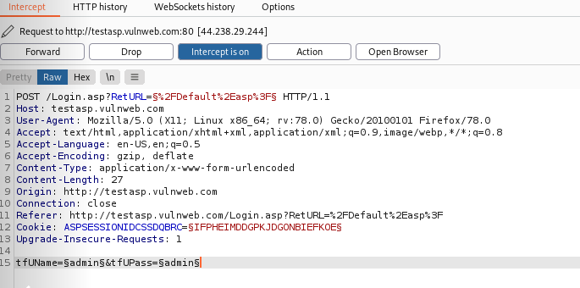
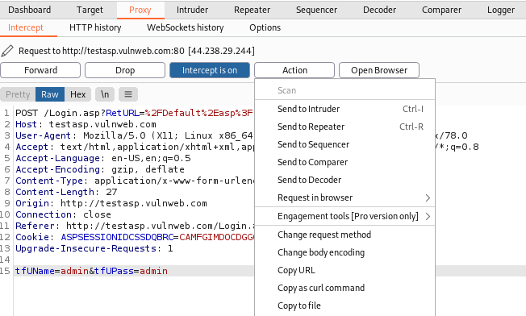
6) Then try to login with username and password , request will send to Burp Suite.
7) Then click on Action a drop-down menu appears.
Then in that drop down menu click
Send to Intruder.

Slide 9
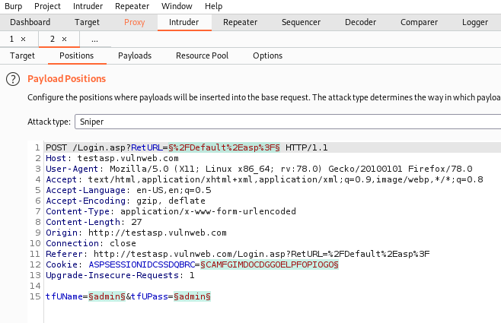
8) Then click on Intruder tab and Click on Position.

Slide 10
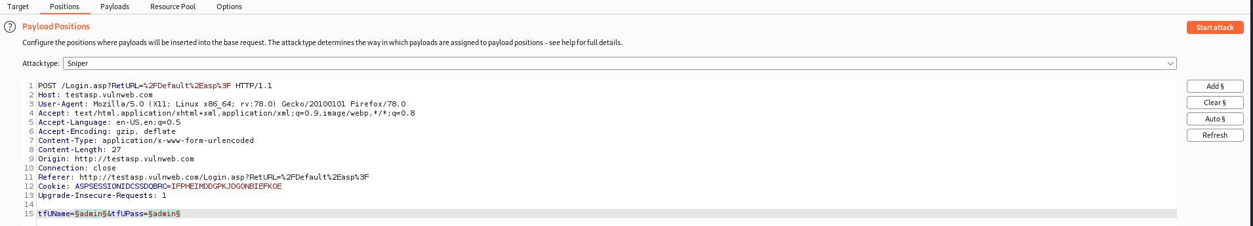
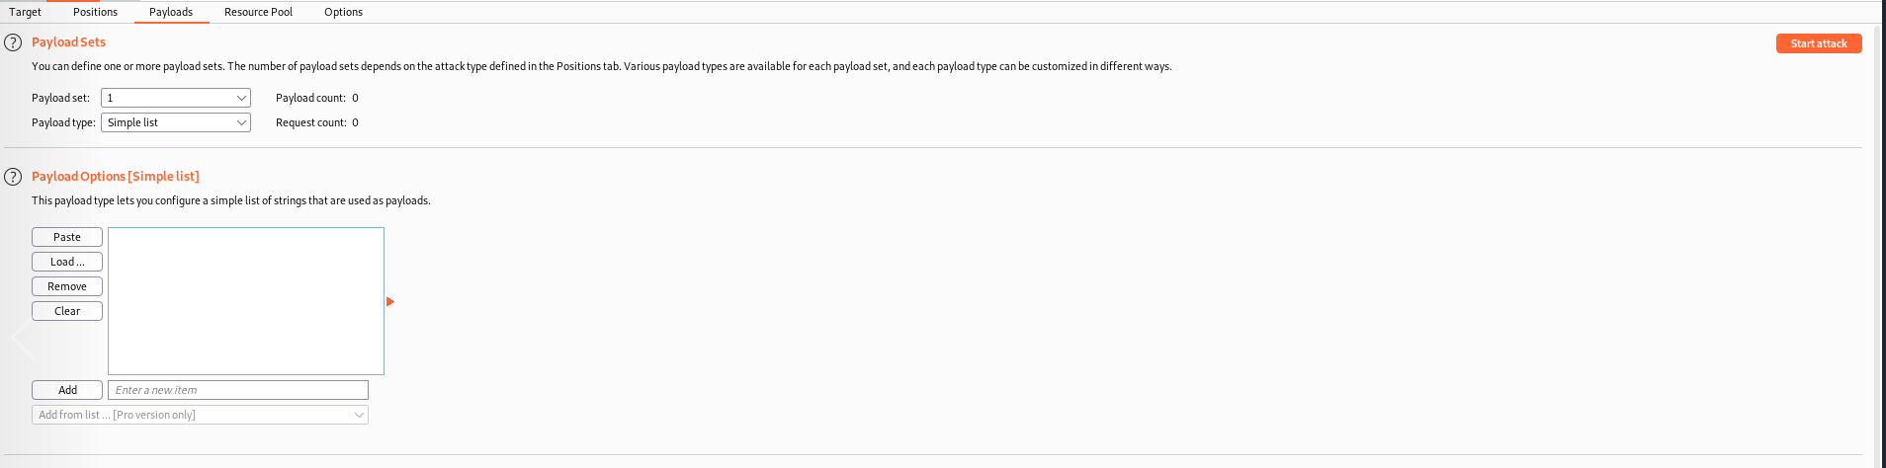
9) Select Uname and UPass and click on ADD$ which is present on right hand side to add to payload position.
10) Then click on Payloads and then in Payload Options click on load and add the payloads. Here the payloads can be downloaded from google (GitHub).

Slide 11
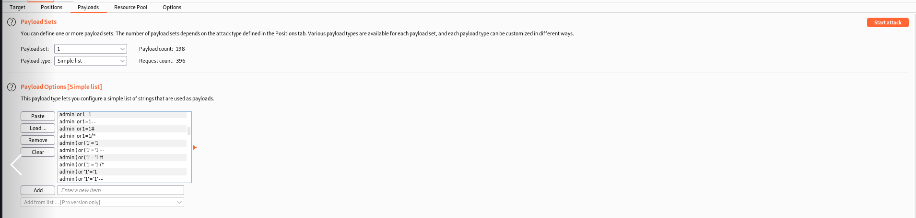
Payload Added

Slide 12
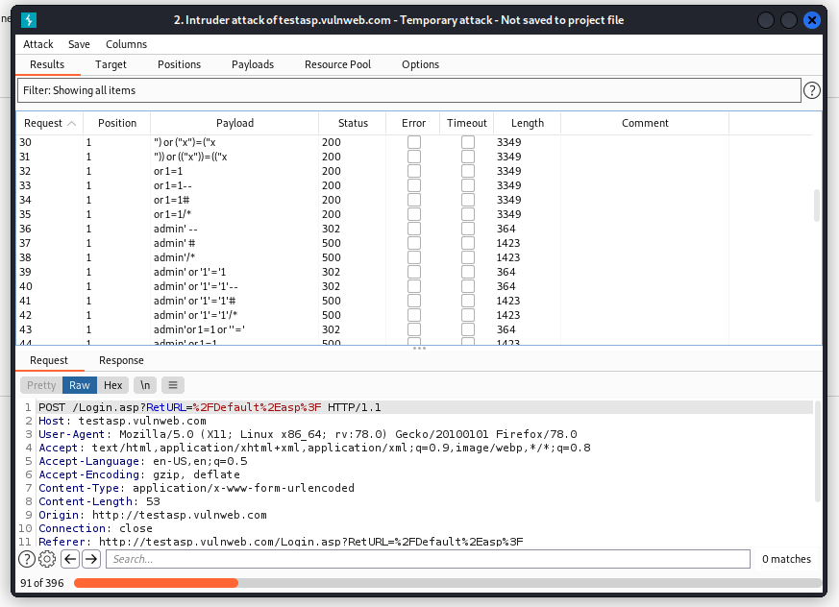
11) Click on the Start Attack. The attack page gets opened as below.

Slide 13
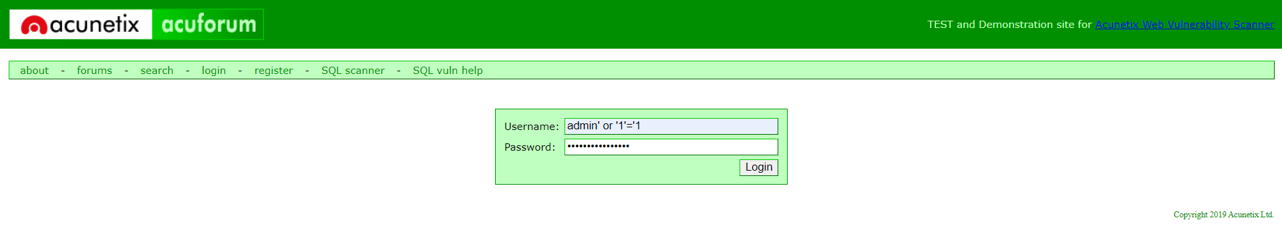
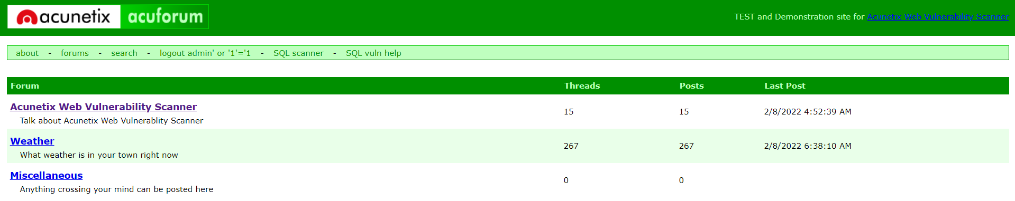
12) Then click and check every payload that each one has given the Bypass to the login page.
Here I have used 39 number Payload which is there in attack
Username: admin’ or ‘1’=‘1
Password : admin’ or ‘1’=‘1
Successfully Login to Website

Slide 14
Impact: -
SQL Injections often let an attacker obtain access to customer records, personally identifiable information (PII), and other confidential data. A successful attack may result in the unauthorized viewing of user lists, the deletion of entire tables and, in certain cases, the attacker gaining administrative rights to a database, all of which are highly detrimental to a business.
Recommendation: -
The only sure way to prevent SQL Injection attacks is input validation and parametrized queries including prepared statements. The application code should never use the input directly. The developer must sanitize all input, not only web form inputs such as login forms.

Slide 15
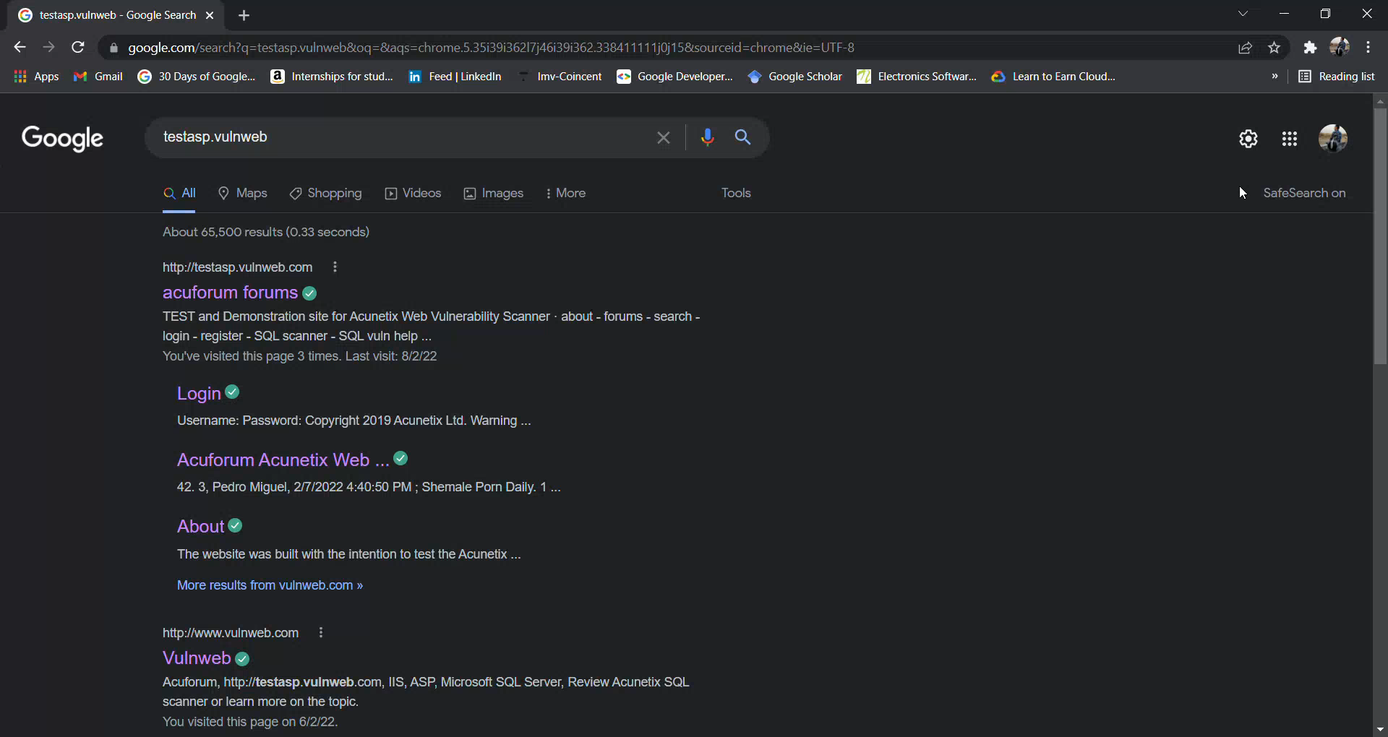
Demo Video

